Slide 1
Introduction to network analysis

Slide 2
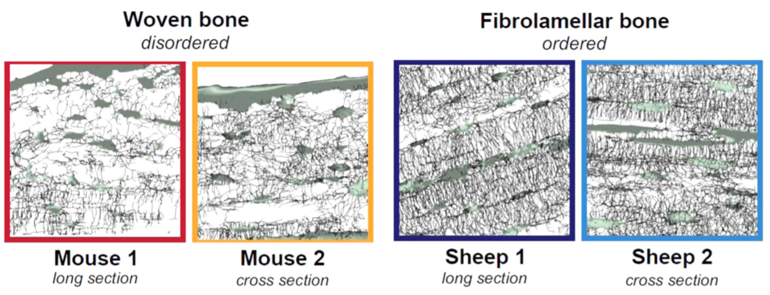
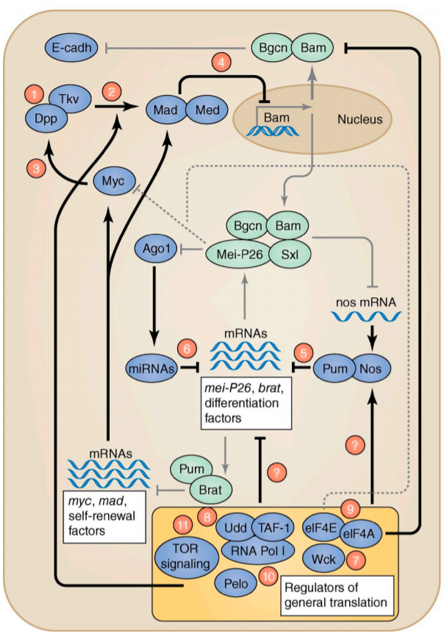
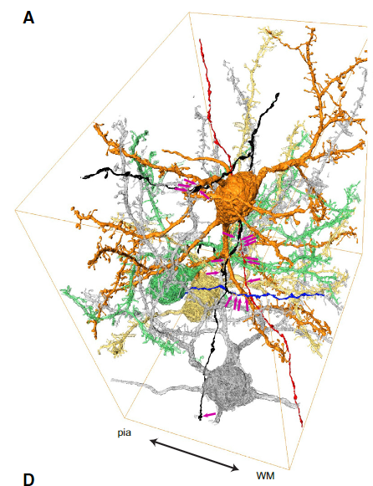
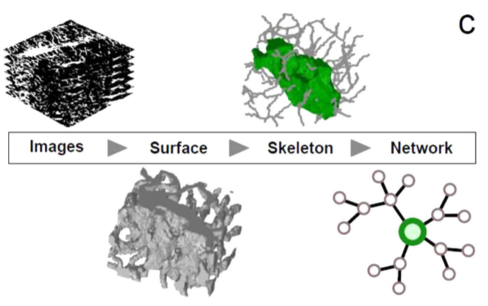
Networks are everywhere
Social networks (https://blog.revolutionanalytics.com/2012/01/visualize-your-facebook-friends-network-with-r.html, Sept 2023)
Networks in bone
Gene regulatory networks
Networks in the brain
Kollmannsberger et al, New Journal of Physics 2017
Berning et al. Neuron 2015
Slaidina & Lehmann JCB 2014

Slide 3
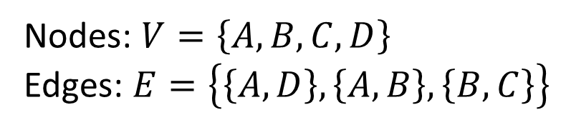
Network analysis
Graph theory is used to analyse the network structure
Graph G consists of the set of nodes V and the set of edges E, thus G=(V,E)
Graph:
B
Node
A
C
Nodes: $V=\left\{A,B,C,D\right\}$
Edges: $E=\left\{\left\{A,D\right\},\left\{A,B\right\},\left\{B,C\right\}\right\}$
D
Edge

Slide 4
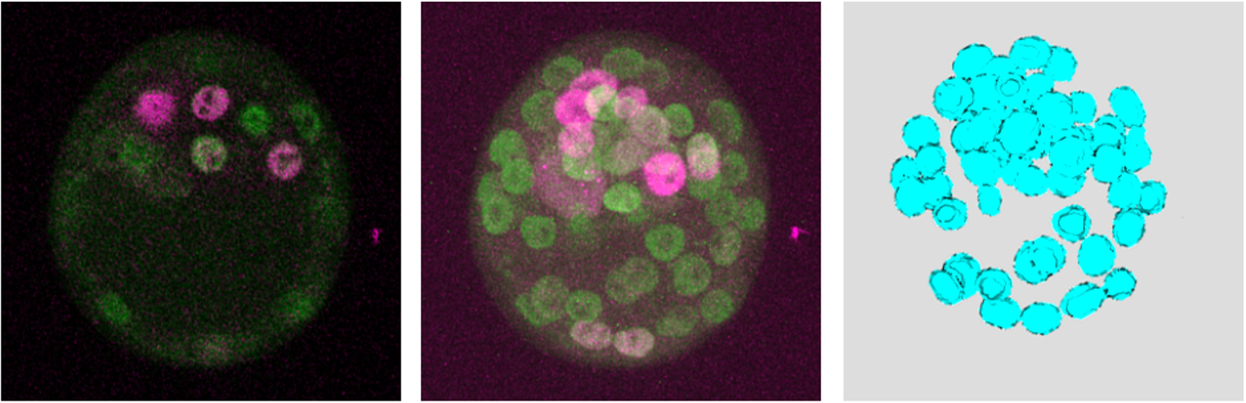
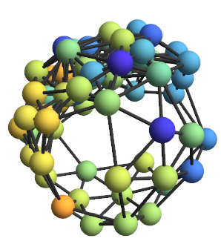
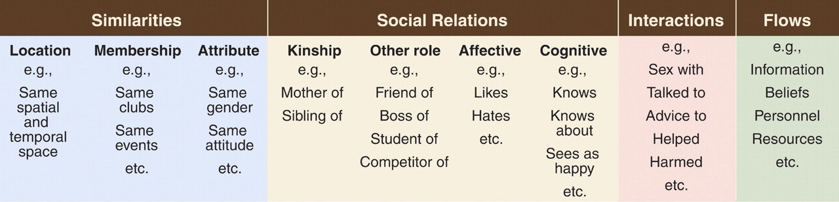
Examples for nodes and edges
Tissue networks
Nodes: cell nuclei
Edges: Neighbourhood
Social network:
Node: Person
Edges:
Fischer et al, Plos One 2020
Borgatti et al, Science 2009

Slide 5

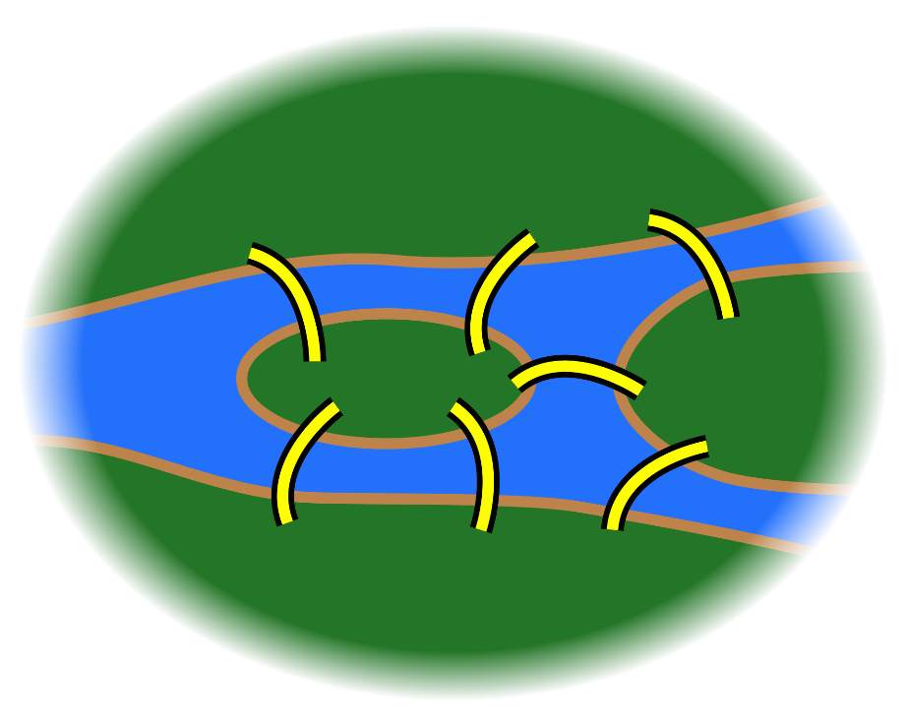
Seven Bridges of Königsberg
Is there a way to cross all seven bridges exactly once?
Königsberg during the early 18th century
In 1736, Euler proved that it is not possible because all nodes have an odd number of edges.
Wikipedia, Juli 2019
Notes:
Graph an der Tafel entwickeln
Maximal zwei Knoten dürfen ungerade Anzahl an Kanten haben, die sind dann Start- und Endpunkt

Slide 6
Types of graphs
Undirected graph
Directed graph

Slide 7
Node positions are irrelevant
=
=

Slide 8
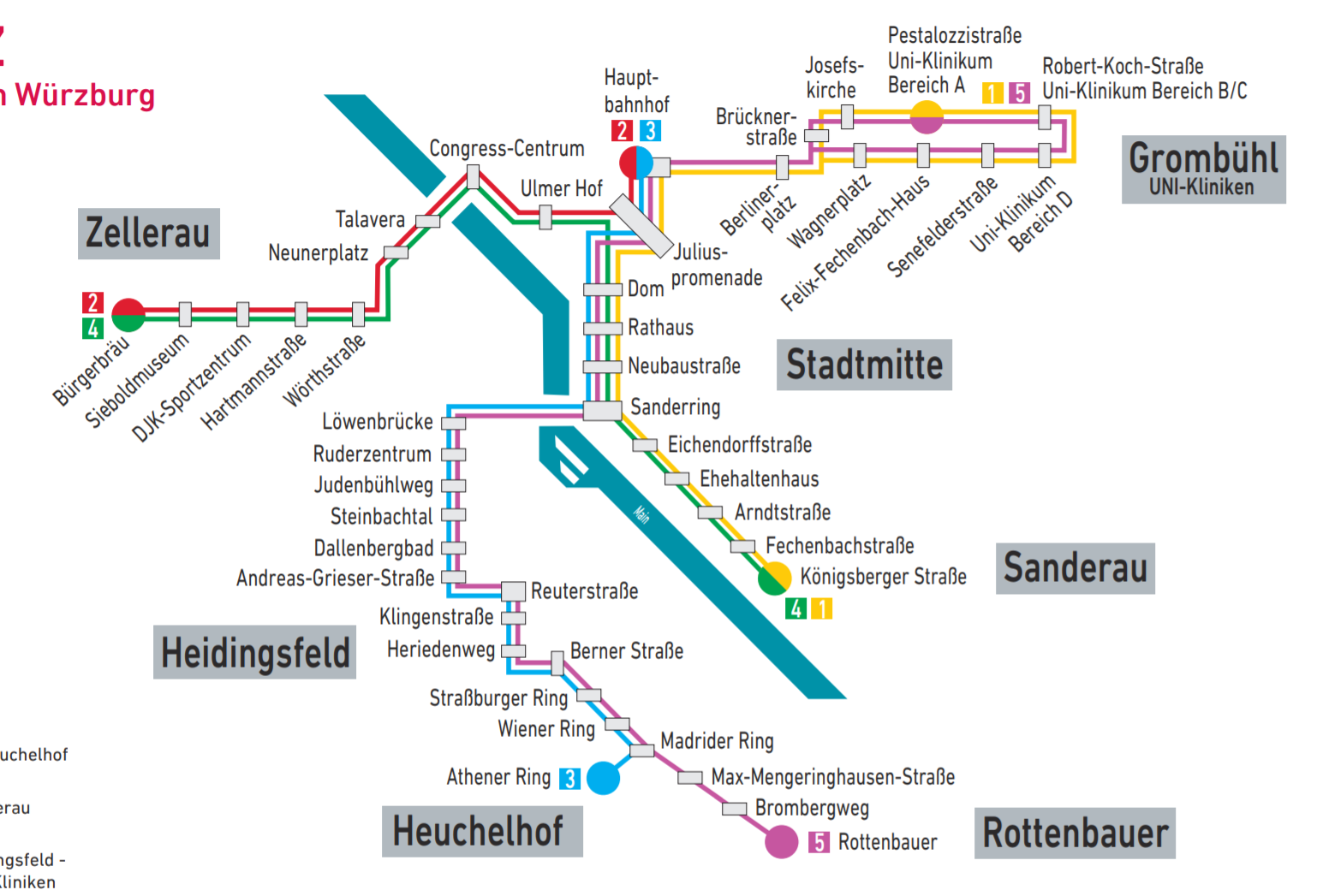
Examples
Grand parents
Uncle
Parents
Aunt
Brother
me
Sister

Slide 9
Trees are also graphs
Connected
Doe snot include closed paths
Undirected Trees
Directed trees
root
inner node
leaf

Slide 10
Edge weights
Uni-Klinikum
5
8
Zellerau
9
Juliuspromenade
18
9
Heuchelhof
20
Sanderau
Rottenbauer
Notes:
Graph an der Tafel entwickeln

Slide 11
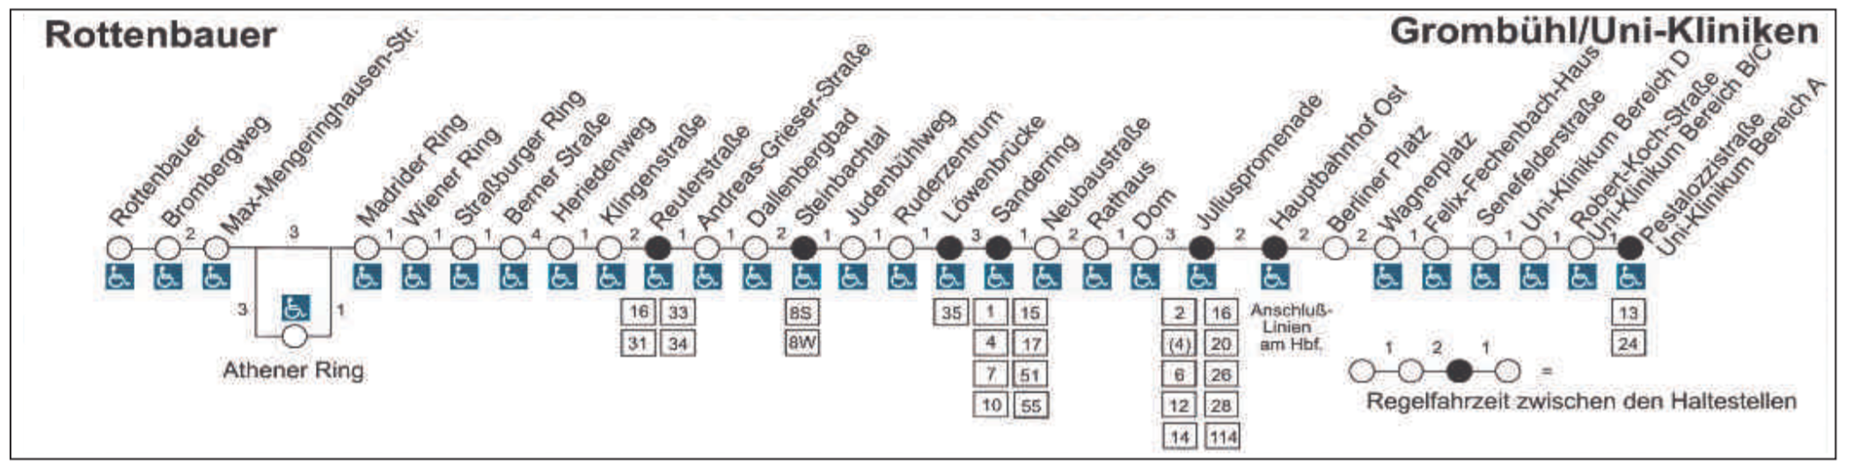
Edge weights

Slide 12
Adjacency list
For an undirected graph, the adjacency list for a node is a list of all its neighbours
For a directed graph, the adjacency list for a node is a list of all its successors
B
Adjacency lists:
A: B,D
B: A,C
C: B
D: A
Adjacency lists :
A:
B: A
C: B
D: A
B
A
C
A
C
D
D
Notes:
Halbzeit

Slide 13
Adjacency matrix
The adjacency matrix of a graph is a matrix in which contains which nodes of the graph are connected by edges.
For different graph types there are different rules for the individual entries.

Slide 14
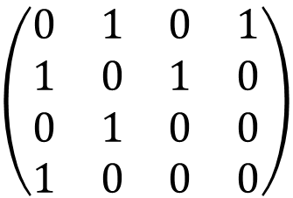
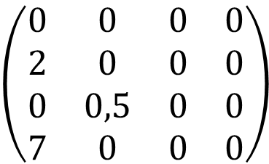
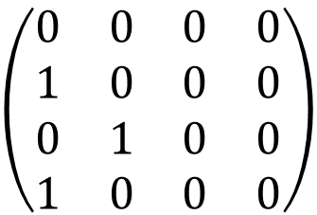
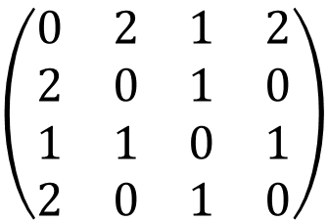
Adjacency matrix for different kinds of graphs
Undirected graph
Directed graph
Directed graph with edge weights
2
2
2
1
1
0,5
2
3
3
2
1
3
1
3
4
4
7
4
4
1 2 3 4
1 2 3 4
1 2 3 4
1 2 3 4
1
2
3
4
$$\left(\begin{matrix}0 & 1 & 0 & 1 \\ 1 & 0 & 1 & 0 \\ 0 & 1 & 0 & 0 \\ 1 & 0 & 0 & 0\end{matrix}\right)$$
1
2
3
4
$$\left(\begin{matrix}0 & 2 & 1 & 2 \\ 2 & 0 & 1 & 0 \\ 1 & 1 & 0 & 1 \\ 2 & 0 & 1 & 0\end{matrix}\right)$$
1
2
3
4
$$\left(\begin{matrix}0 & 0 & 0 & 0 \\ 1 & 0 & 0 & 0 \\ 0 & 1 & 0 & 0 \\ 1 & 0 & 0 & 0\end{matrix}\right)$$
1
2
3
4
$$\left(\begin{matrix}0 & 0 & 0 & 0 \\ 2 & 0 & 0 & 0 \\ 0 & 0,5 & 0 & 0 \\ 7 & 0 & 0 & 0\end{matrix}\right)$$
Notes:
Matrizen an der Tafel berechnen

Slide 15
Adjacency matrix
The adjacency matrix of a graph is a matrix in which contains which nodes of the graph are connected by edges.
For different graph types there are different rules for the individual entries.
The adjacency matrix of an undirected graph is always symmetric (it is sufficient to store only one half).
For graphs without edge weights and without multiple edges, only 1 and 0 occur as entries

Slide 16
Graph analysis
There are many graph features that can be measured.
Many of these are implemented in networkX: (https://networkx.github.io/documentation/stable/reference/algorithms/index.html)
The values describe either properties of the whole graph or individual nodes.

Slide 17
Node degree
Undirected graph:
Number of edges at a node
For graph without edge weights, this corresponds to the sum of the entries of the corresponding row or column in the adjacency matrix.
Directed graph:
A distinction is made between input degree (number of edges arriving) and output degree (number of edges leaving).
Input degree for graph without edge weights: Sum of the corresponding column in the adjacency matrix.
Output degree for graph without edge weights: sum of the corresponding row in the adjacency matrix
Statistics (maximum, minimum, arithmetic mean, ...) for the node degree describe the graph as a whole.

Slide 18
Path
2
Sequence of nodes that are successively connected in pairs by edges
1
3
4
5
4
3
Number of paths from 1 to 5?
Shortest path from 1 to 5?
1
2

Slide 19
Connectivity
An undirected graph is called connected if there is an undirected path between every two nodes in the graph.
A directed graph is called connected if there is a directed path between every two nodes in the graph.
2
B
B
1
3
A
A
C
C
4
D
D

Slide 20
Connectivity
Minimum number of nodes to remove in a graph so that it is no longer connected
5
2
1
4
3
3
4
1
2
connectivity: 1
connectivity: 2
Local connectivity for two nodes: minimum number of nodes in between that must be removed for the two to no longer be connected

Slide 21
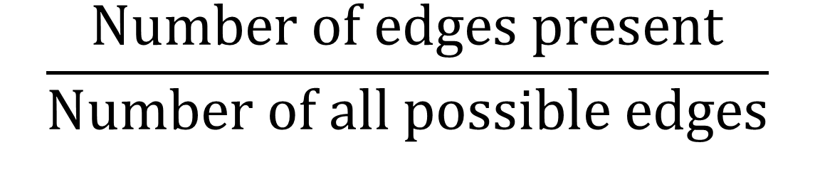
Density
$$\frac{\text{Number} \text{of} \text{edges} \text{present}}{\text{Number} \text{of} \text{all} \text{possible} \text{edges}}$$

Slide 22
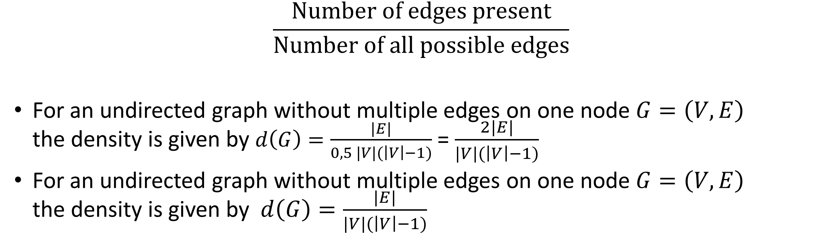
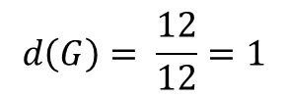
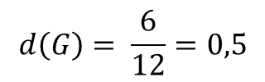
Density
$$\frac{\text{Number} \text{of} \text{edges} \text{present}}{\text{Number} \text{of} \text{all} \text{possible} \text{edges}}$$
For an undirected graph without multiple edges on one node $G=\left(V,E\right)$ the density is given by $d\left(G\right)=\frac{|E|}{0,5 |V|(\left|V\right|−1)}$ = $\frac{2|E|}{|V|(\left|V\right|−1)}$
For an undirected graph without multiple edges on one node $G=\left(V,E\right)$ the density is given by $d\left(G\right)=\frac{|E|}{|V|(\left|V\right|−1)}$
2
2
1
Complete graph
1
3
3
4
4
$$d\left(G\right)= \frac{6}{12}=0,5$$
$$d\left(G\right)= \frac{12}{12}=1$$
Notes:
Formeln an der Tafel erklären

Slide 23
Local clustering coefficient
Proportion of the number of edges between the nodes within its neighbourhood divided by the number of edges that could possibly exist between them.
2
2
2
1
1
1
3
3
3
4
4
4
clustering coefficient:
1
1/3
0

Slide 24
Centrality
Describes the importance of a node in a graph
Examples:
Person with the greatest influence in a social network
Key infrastructure nodes in a transport network
Cells that are key signalling sources in a tissue

Slide 25
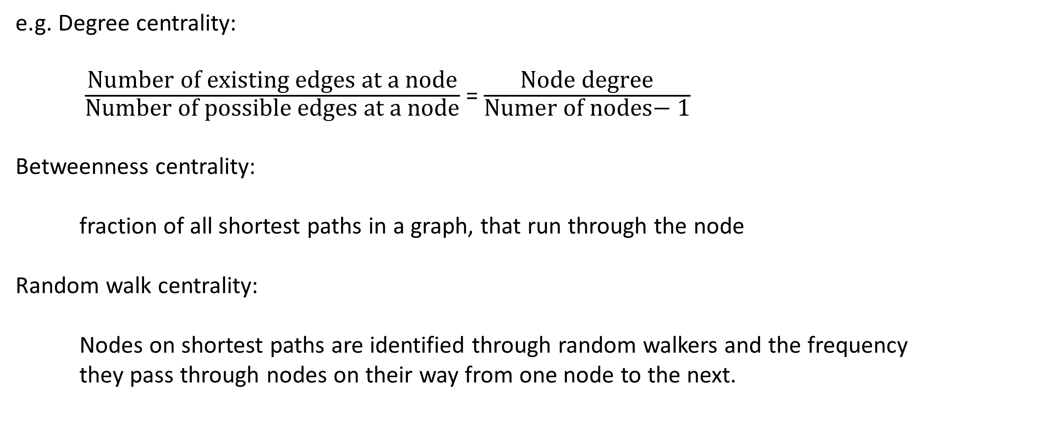
Centrality
e.g. Degree centrality:
$\frac{\text{N}\text{umber} \text{of} \text{existing} \text{edges} \text{at} \text{a} \text{node}}{\text{N}\text{umber} \text{of} \text{possible} \text{edges} \text{at} \text{a} \text{node}}$ = $\frac{\text{Node} \text{degree}}{\text{N}\text{umer} \text{of} \text{nodes}\text{− 1}}$
Betweenness centrality:
fraction of all shortest paths in a graph, that run through the node
Random walk centrality:
Nodes on shortest paths are identified through random walkers and the frequency
they pass through nodes on their way from one node to the next.
Notes:
Betweenness centrality:
Need to know the whole network
In biological tissue only parts of the network are known: Random walk centrality

Slide 26
Clique
Subset of nodes in a graph in which each pair of nodes is connected by an edge, i.e. complete.
2
2
1
1
3
3
4
4

Slide 27
Summary
Network structures are analysed with graph theory
A graph consists of nodes and edges
Different types of graphs
Adjacency lists and adjacency matrix facilitate the storage and analysis of graphs
Measurements for whole graphs and for individual nodes

